Slide 1

Notes:
Guide to a successful PowerPoint design – simple is best
Use the template wisely, make design amends that help your communication, do not alter the core design of the slide.
Use only one key message per slide. If you have more than one message, use more slides.
Some argue the target number of words on a slide should be 6. Limit the amount of text on each slide, and include copy in your notes.
Maintain a consistent design throughout - colours, fonts, graphics and images.

Slide 2
BMJ Journals
Online Collection
http://journals.bmj.com
A guide to the BMJ Journals websites –
what they can do and how to use them
Notes:
Design tips - narrative
Always consider your audience, who are they, what do they expect, how much will they know, what are the key messages they need to take away?
Tell a story - have a beginning a middle and an end.
Slides should follow a natural progression.
Remember the three times rule - tell your audience what you are going to tell them, tell it, and then summarise it.
Design tips – colour and images
Avoid using all the available colours. Blue is always our core colour, try not to use more than 2 secondary colours from the palette and only one secondary colour can be used on any given slide.
Use images carefully. They should help the audience relate slide information to real world situations. Always ensure good legibility is maintained when text is placed over images.
Do not use clipart.
Use graphics after careful consideration. Only use them if it adds to the communication.
Additional logos – for partners or other parties you co-present with – please place the logo in the bottom right hand corner

Slide 3
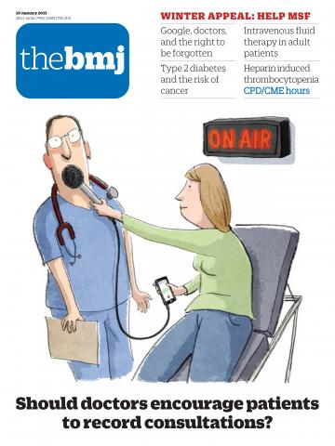
BMJ简介
成立于 1840 年，有 170 多年的历史
直属于英国医学会
以其旗舰期刊《英国医学杂志》缩写命名
致力于促进世界医学发展和患者健康改善
影响全球160多个国家和地区的读者和用户
总部设于伦敦，在美国、印度、巴西、中国有分部

Slide 4

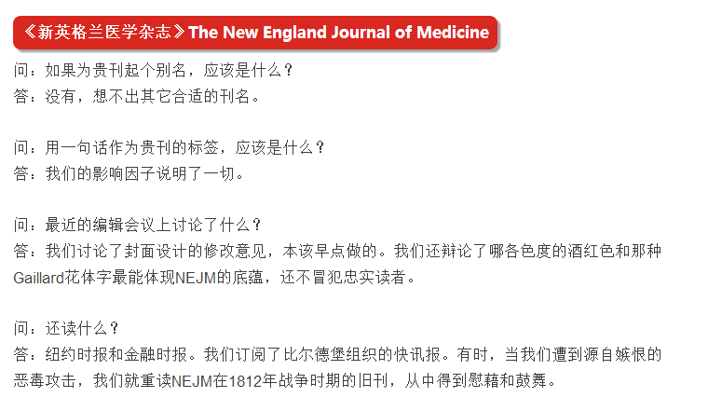


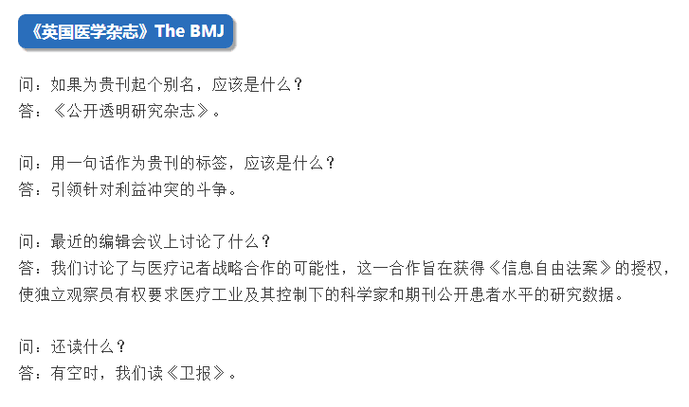

Slide 5








在临床实践及科研方面，涵盖各学科最新临床进展

Slide 6
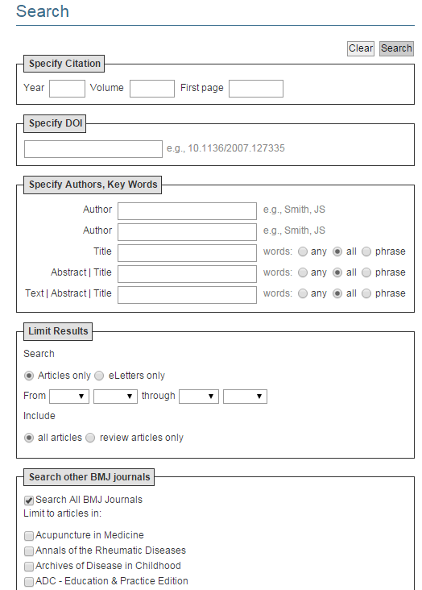
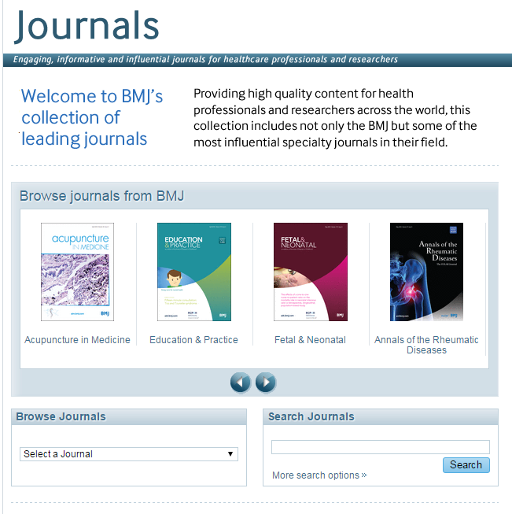
检索
跨刊主题检索
单刊浏览
高级检索设置

Slide 7
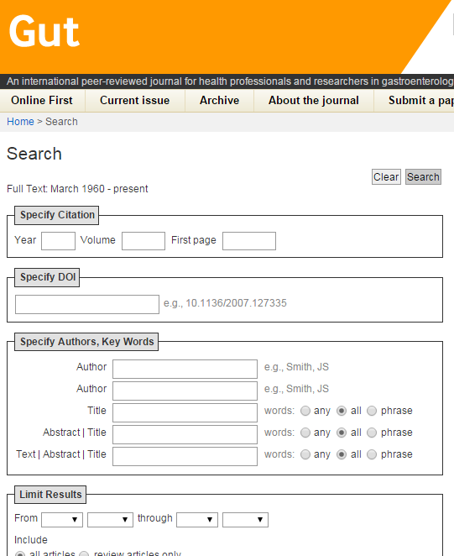
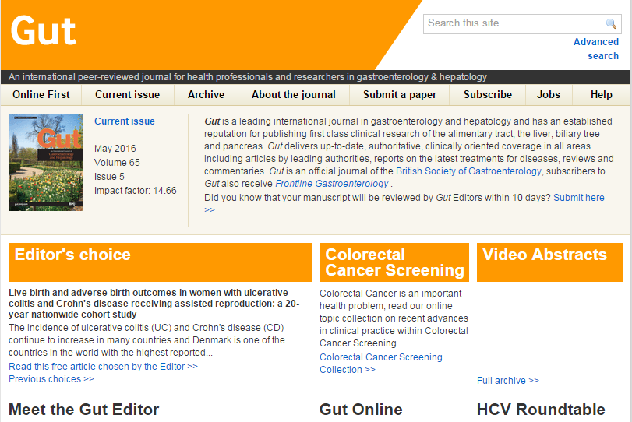
检索
单刊主题检索

Slide 8
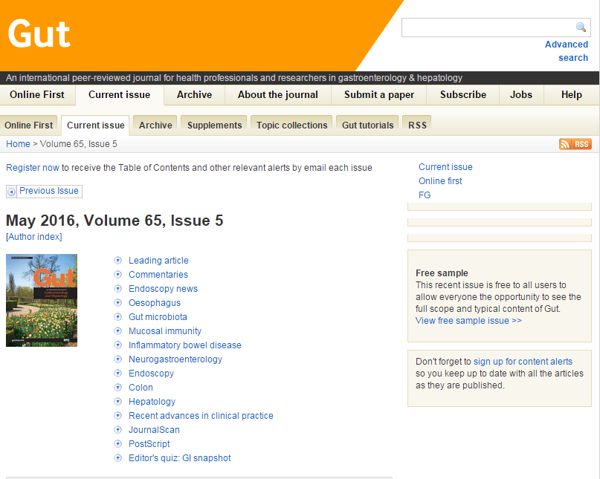
最新一期（Current Issue）

Slide 9
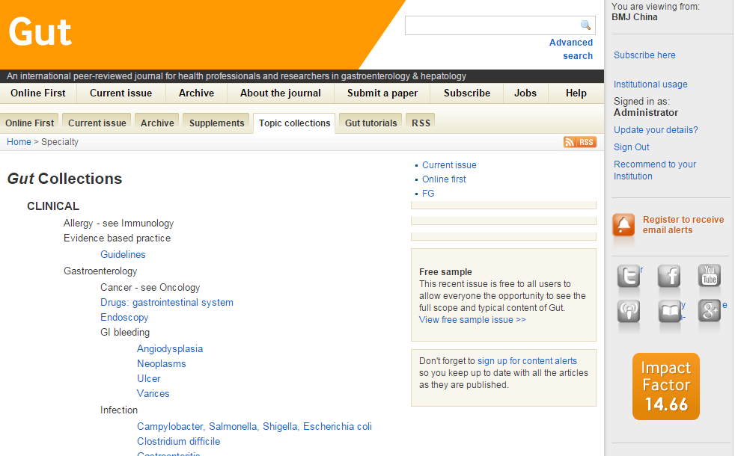
Topic collections
‘
Current Issue’ 标签页下的‘Topic collections’可以帮读者找到感兴趣的内容.
BMJ Journals online的每一篇文章都被划分到一个主题类别，作为BMJ电子版的原创设计，可以更容易的跨刊检索
BMJ Journals 有超过250 临床和非临床的topic collections.

Slide 10
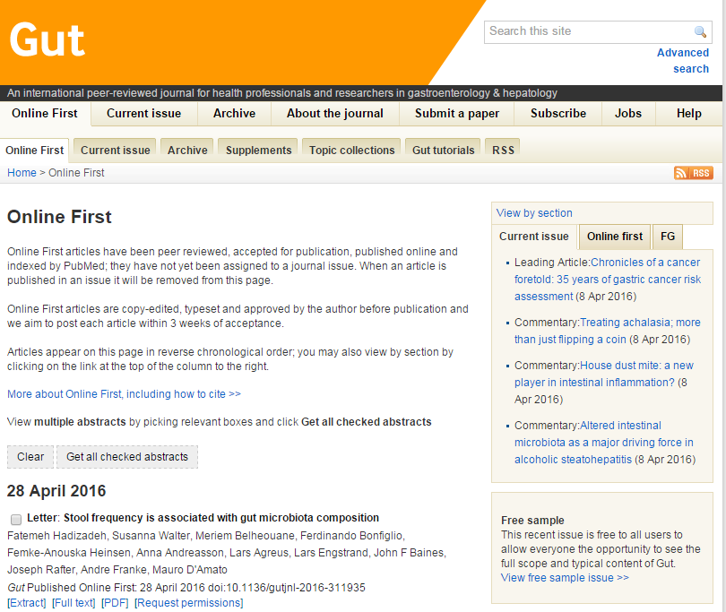
在线优先出版
已被接收但尚未出版的文章可提前从网站获取，通过我们的网站，可浏览这些文章的原始手稿
通过期刊首页的‘Online First’ 可以查看这些文章

Slide 11
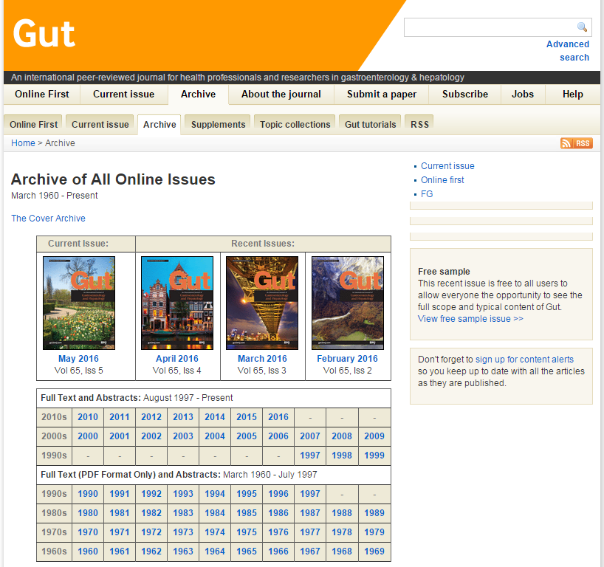
过往巻期查询
可查看该刊历年文献

Slide 12
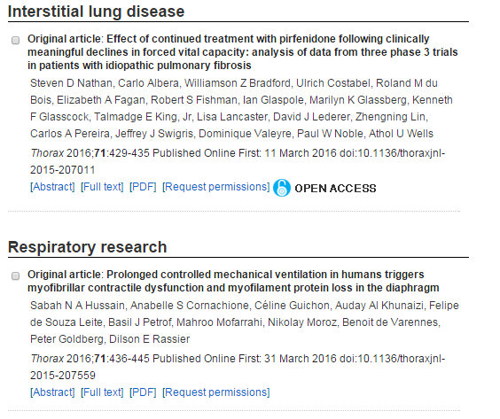
文章浏览方式
每篇文章都有摘要、题录、全文或pdf格式
文章摘要和题录免费获取

Slide 13
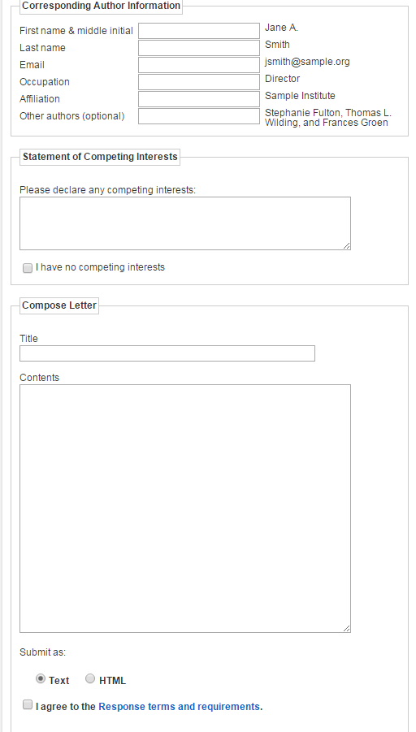
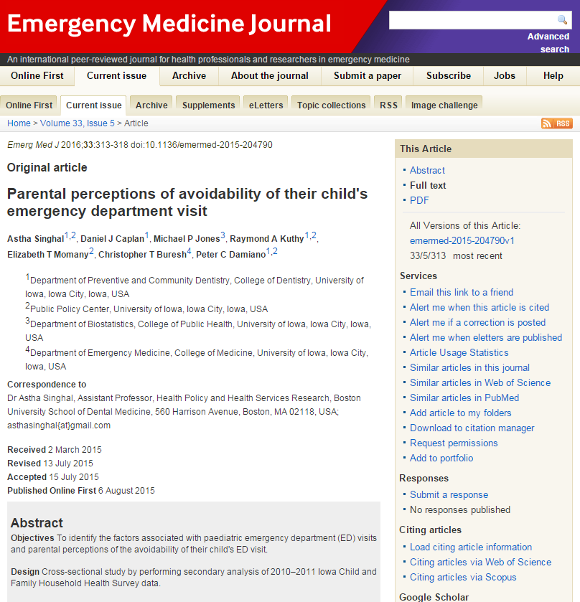
文章内特色功能-与作者互动

Slide 14
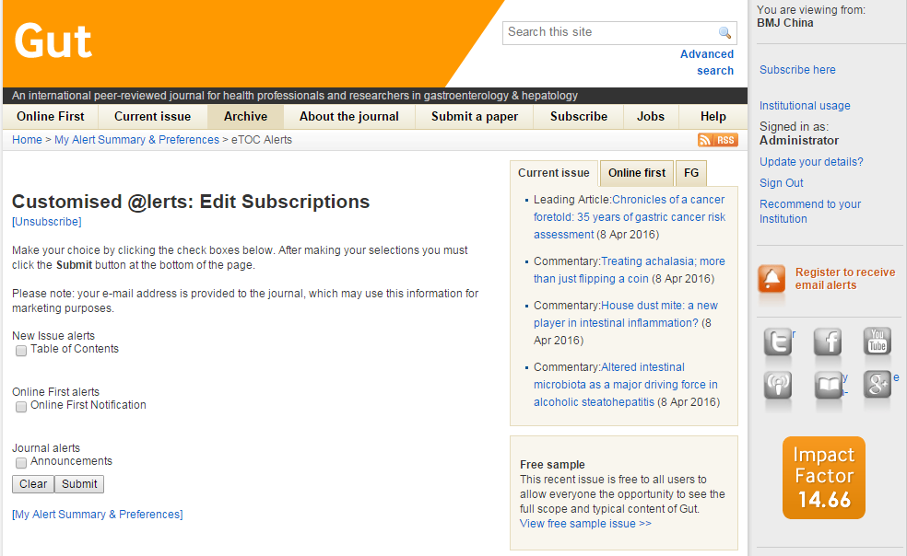
邮件提醒
邮件提醒服务可帮助读者知晓期刊的最新在线发行动态；通过该邮件，读者还可以直接浏览最新内容，如文章、信件和评论。
在期刊任意页面都有该图标

Slide 15
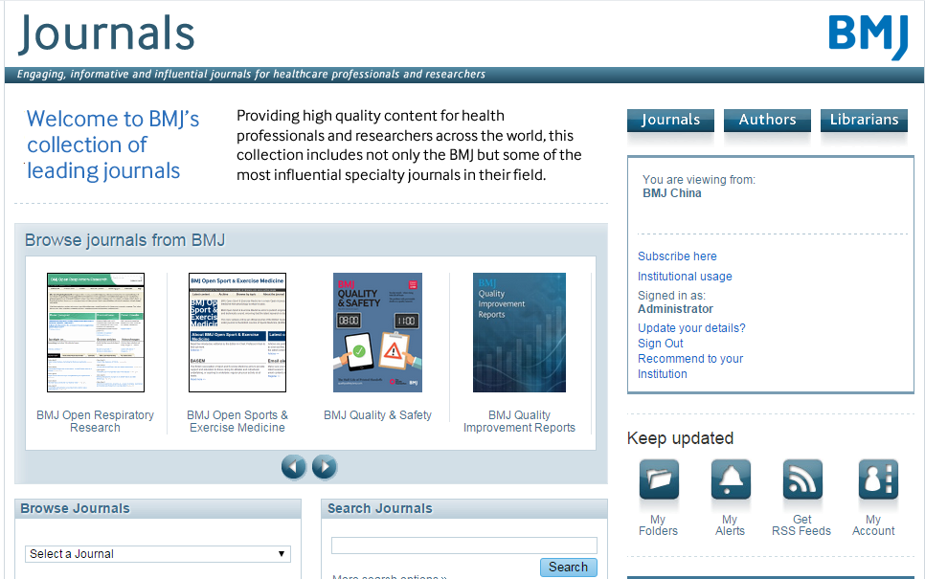
Keep updated

Slide 16
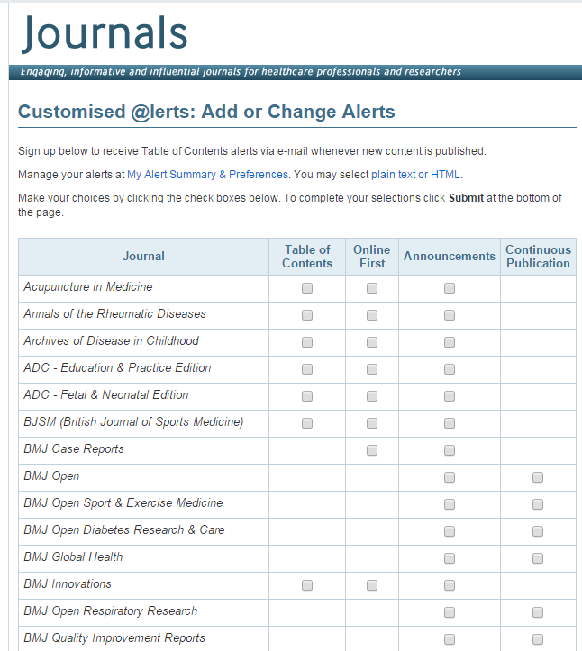
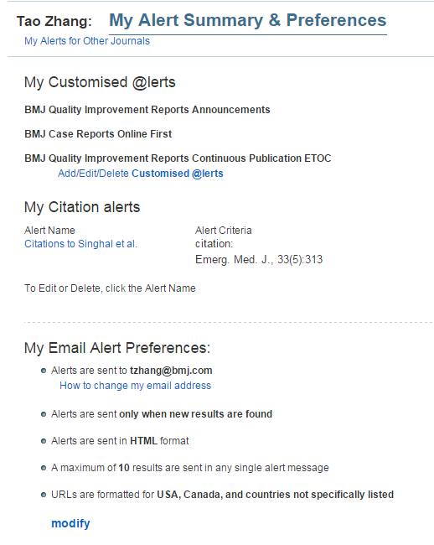
My alert

Slide 17
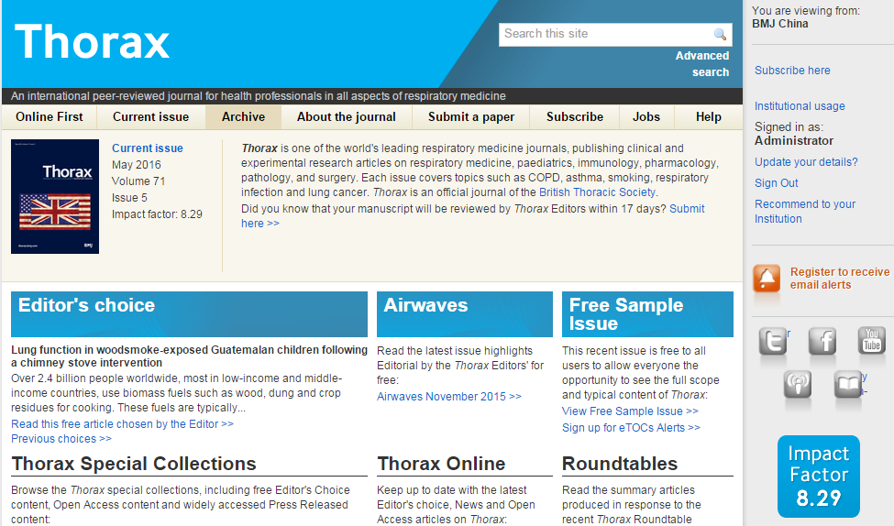
提交手稿
通过ScholarOne 系统， BMJ 所有期刊均可在线进行手稿提交及跟踪。可通过 期刊首页的‘Submit a paper’ 或 ‘About the journal’ 了解详情。

Slide 18
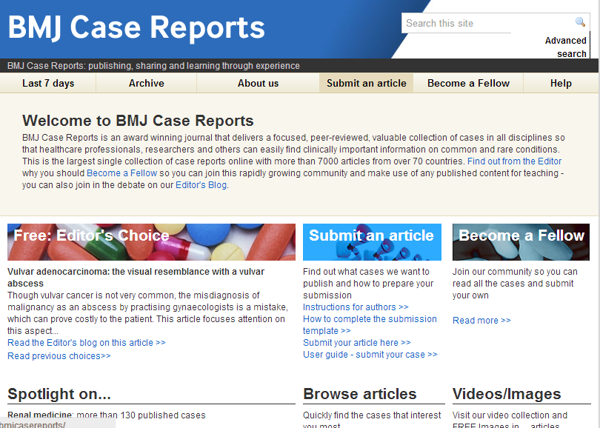

Slide 19
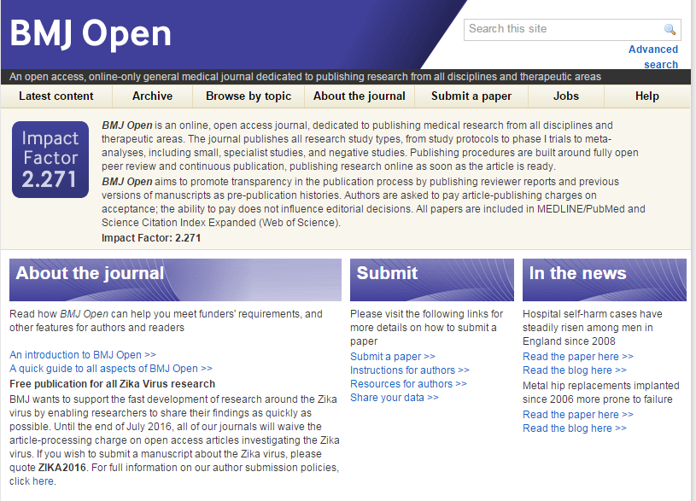
http://bmjopen.bmj.com/
Open access
Open peer review
Data sharing
Launch date:2011
IF：2.562
Acceptance rate: 60%

